Slide 1
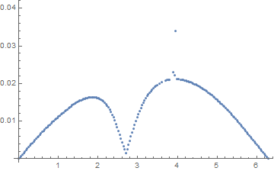
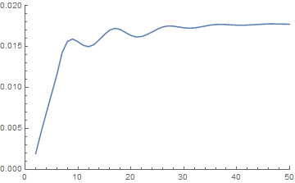
















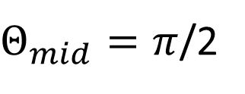











$$L_{mid}$$
$$φ_{1}$$
$$φ_{mid}=0$$
$$φ_{2}=0$$
$$Θ_{1}=0$$
$$Θ_{2}=π$$
$$Θ_{mid}$$
$I_{max}$($Δ$)
$$I_{max}(Δ)$$
$$0.04$$
$$0.02$$
$$L_{mid}=10$$
$$0.02$$
$$0.01$$
$Θ_{mid}=π$/2
$$0.00$$
$$0.00$$
$$π/2$$
$$π$$
$$3π/2$$
$$2π$$
$$10$$
$$20$$
$$30$$
$$40$$
$$50$$
$$Θ_{mid}$$
$$L_{mid} (sites)$$

